Slide 1

Franchisee Setup Training

Slide 2
Checklist
Have you completed…?
Before you delve deeper into the features of Franscape, make sure you have completed the tasks from the first set of training:
Added your Venues
Added your Instructors
Added Your Courses
Added your Classes
Connected your Stripe Account

Slide 3
Content
About This Training
The following training expands on the detail of various elements of Franscape, giving you an idea of what can be achieved with:
Venues
Instructors
Courses
Classes & Lessons
Customers
Consumers
Transactions

Slide 4
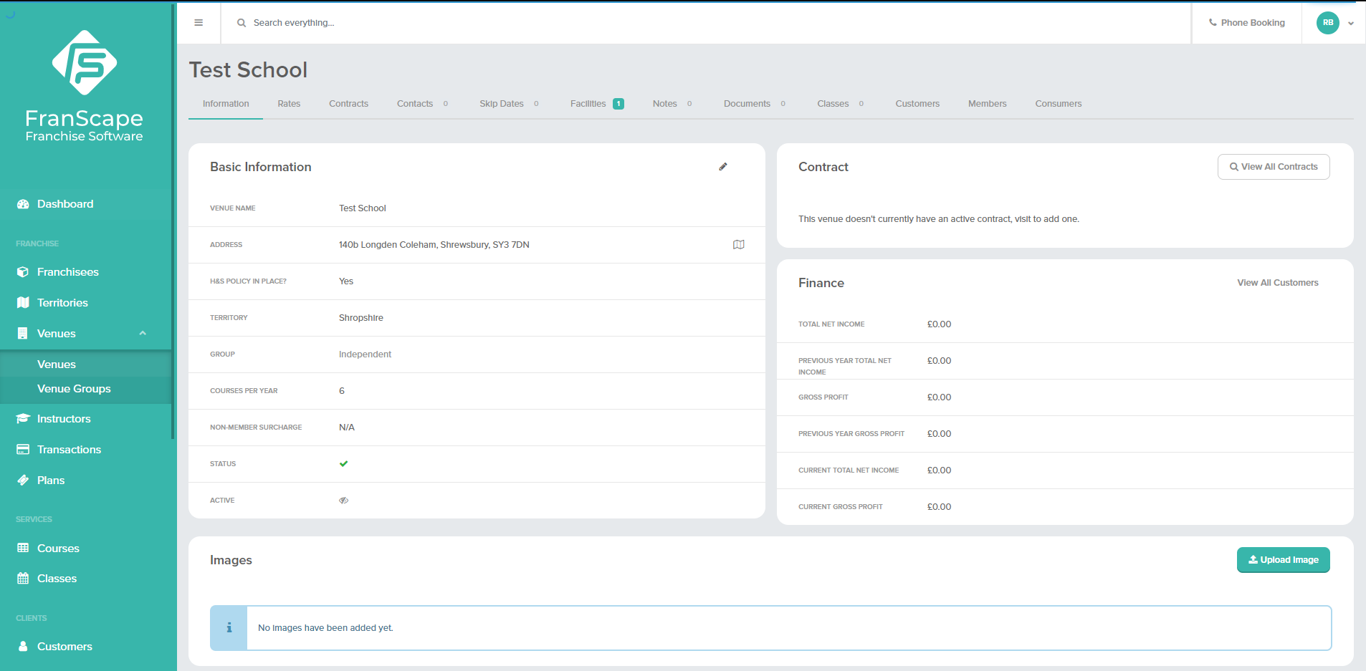
Venues
About Venues
Click on the image below to play the video – you may need to right click for it to open. (an internet connection is required)

Slide 5
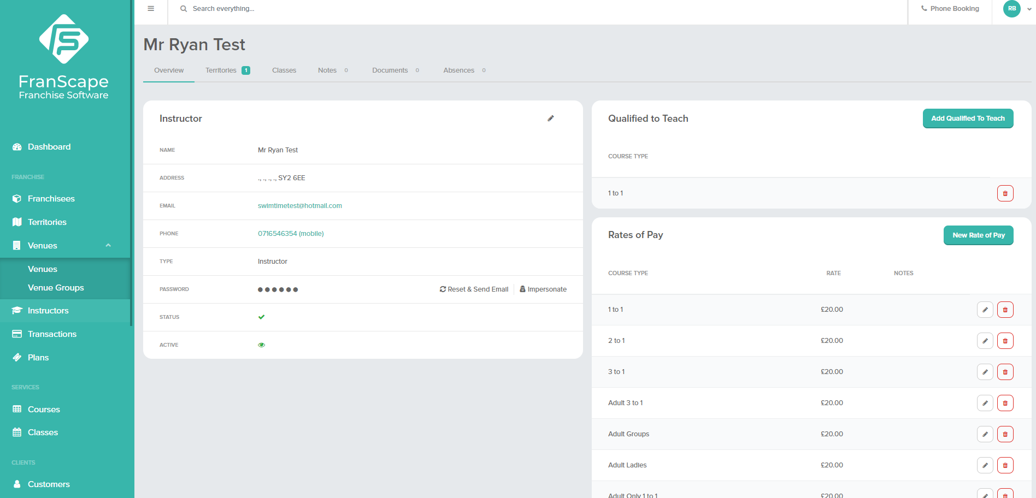
Instructors
About Instructors
Click on the image below to play the video – you may need to right click for it to open. (an internet connection is required)

Slide 6
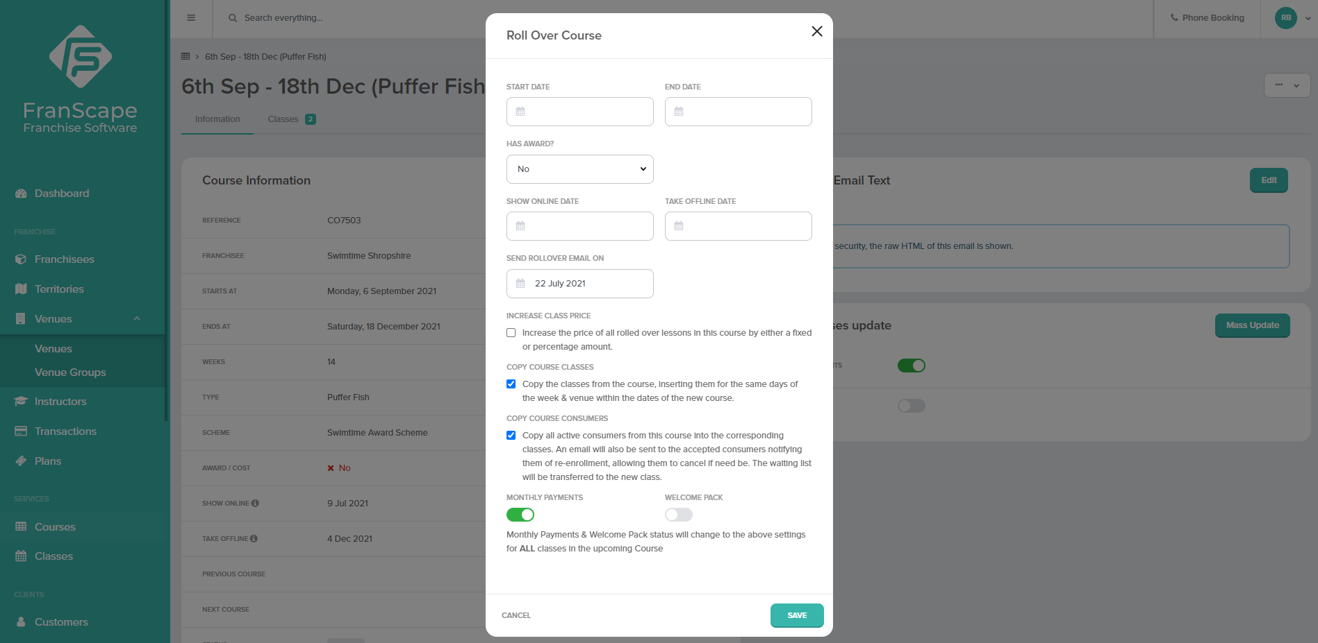
Courses
Course Rollovers
Click on the image below to play the video – you may need to right click for it to open. (an internet connection is required)

Slide 7
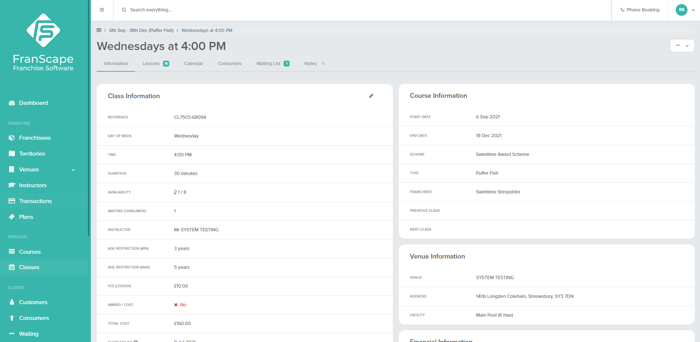
Classes
About Classes & Lessons
Click on the image below to play the video – you may need to right click for it to open. (an internet connection is required)

Slide 8
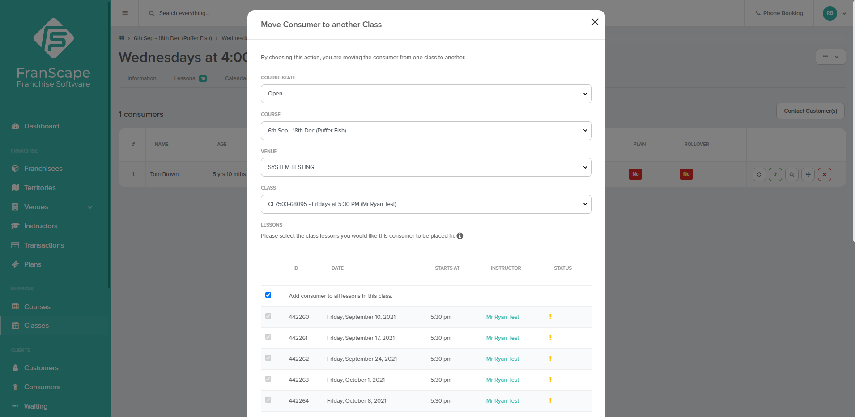
Classes
Moving Consumers Between Classes
Click on the image below to play the video – you may need to right click for it to open. (an internet connection is required)

Slide 9
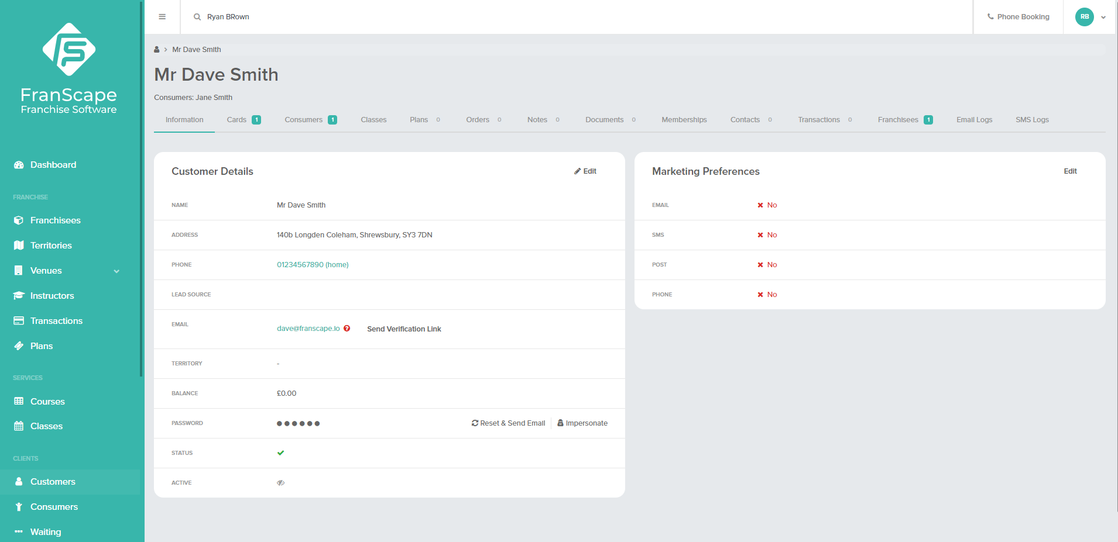
Customers
About Customers
Click on the image below to play the video – you may need to right click for it to open. (an internet connection is required)

Slide 10
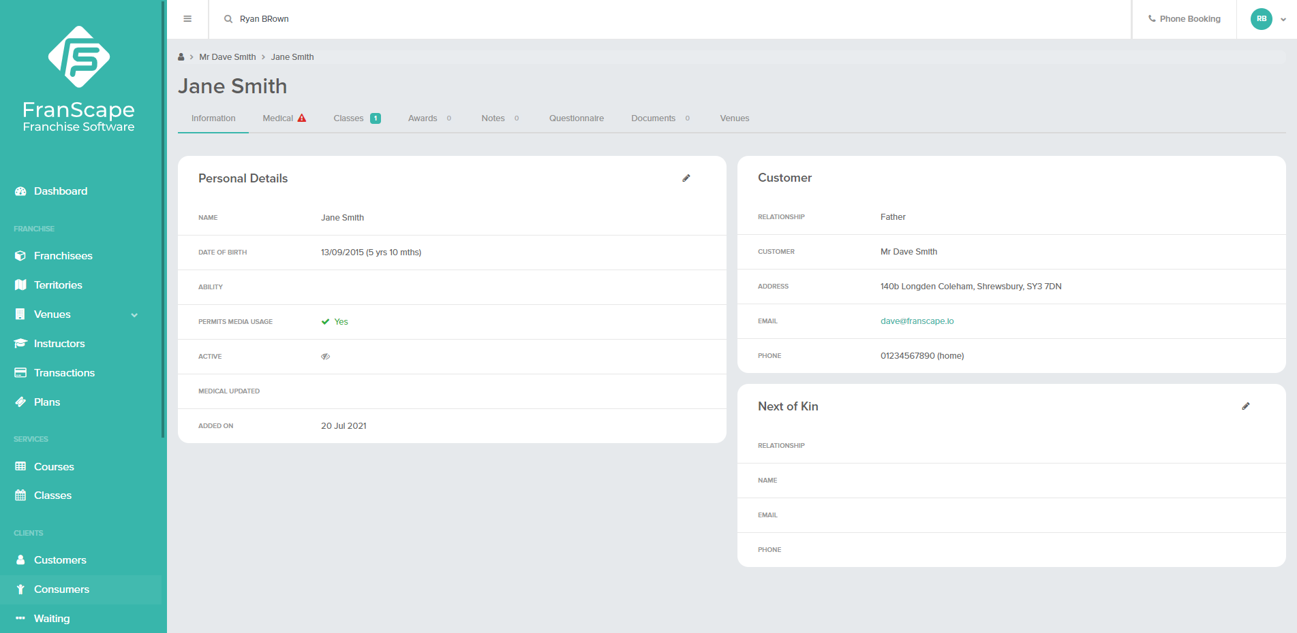
Consumers
About Consumers
Click on the image below to play the video – you may need to right click for it to open. (an internet connection is required)

Slide 11
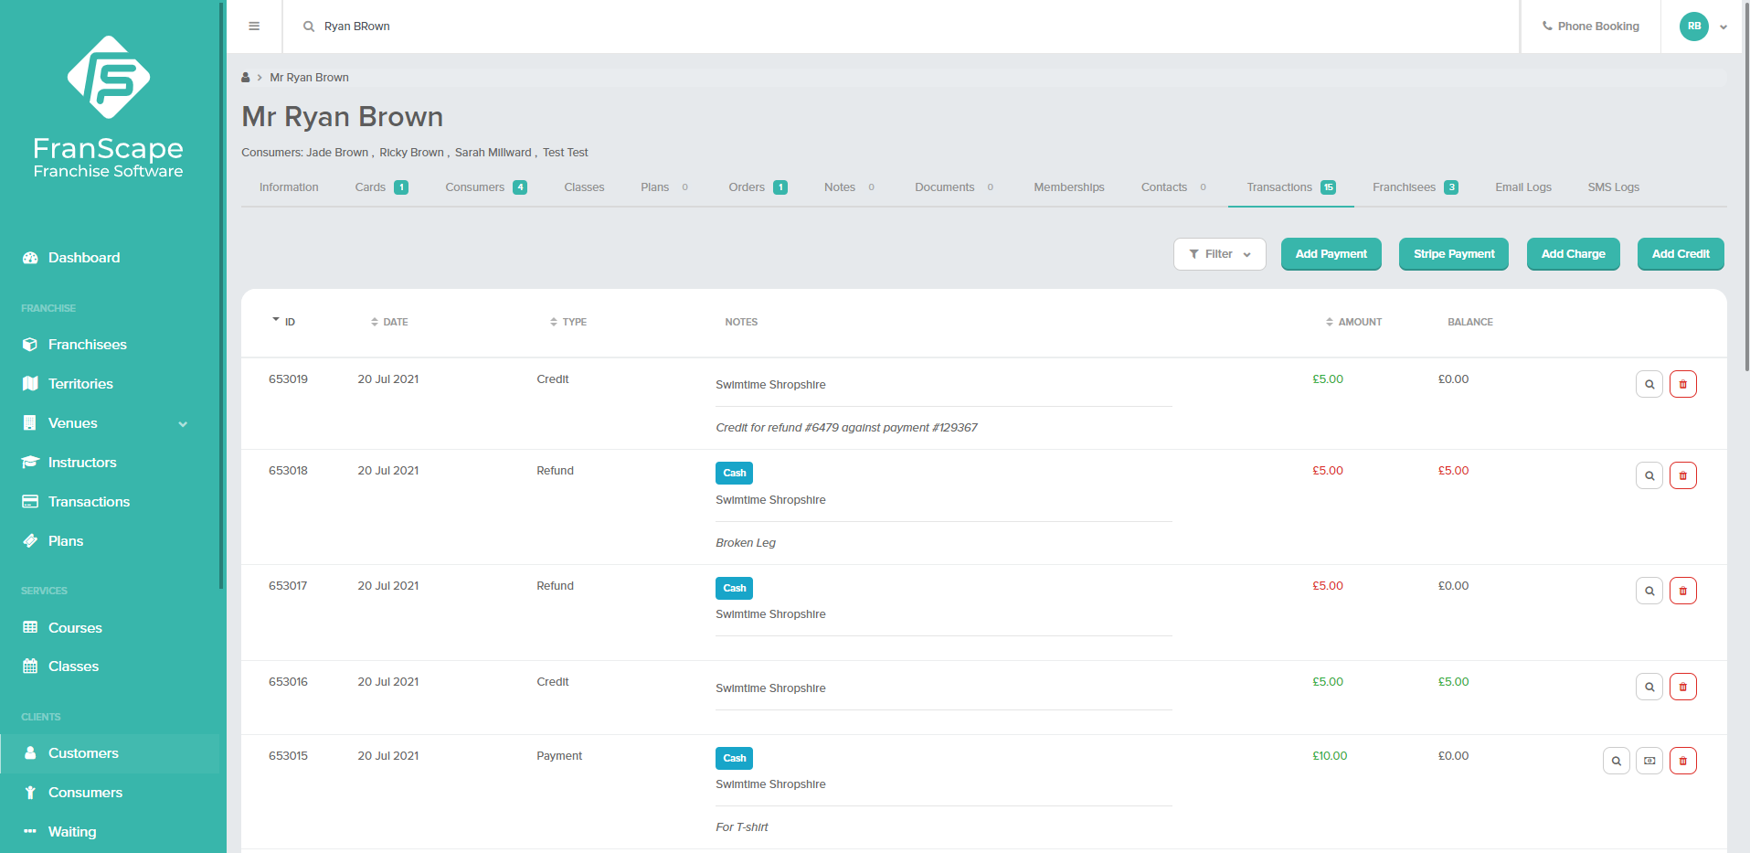
Customers
Transactions
Click on the image below to play the video – you may need to right click for it to open. (an internet connection is required)

Slide 12
Check out the Franscape Knowledge Base for more instructional articles
If you need support, contact support@franscape.io

