Slide 1

Managing the Monthly Plan

Slide 2
Content
In this training we will cover:
Switching a Consumer from Pay in Advance to Monthly
Managing a Monthly Plan
14-Day Cancellations
30-Day Cancellations

Slide 3
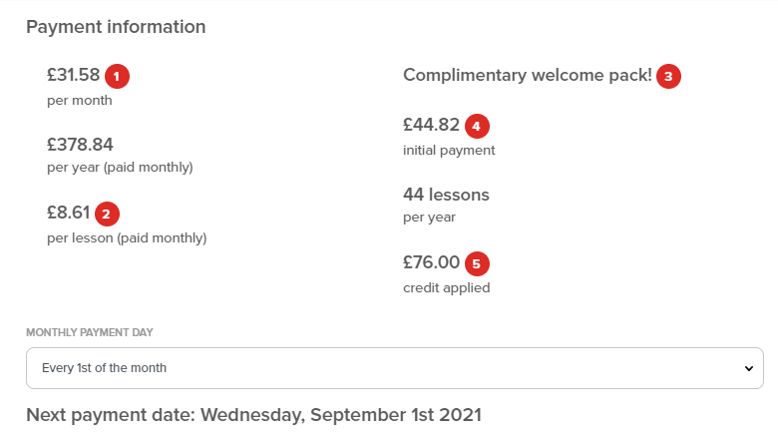
Switch
Switching a Consumer from Pay in Advance to Monthly
A Customer can do this via their Online Account at any time. They are also offered the chance when they re-enrol.
Click on the image below to play the video – you may need to right click for it to open. (an internet connection is required)

Slide 4
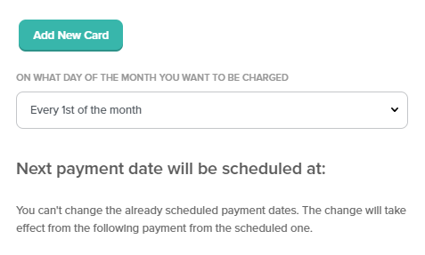
Manage
Managing a Monthly Plan
Learn how to edit and manage a Monthly Plan.
Click on the image below to play the video – you may need to right click for it to open. (an internet connection is required)

Slide 5
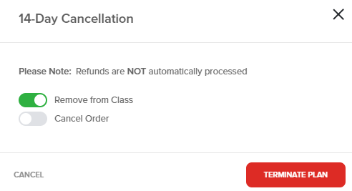
Cancel
14-Day Cancellations
What to do if a Monthly Plan Customer wants to cancel within 14 days.
Click on the image below to play the video – you may need to right click for it to open. (an internet connection is required)

Slide 6
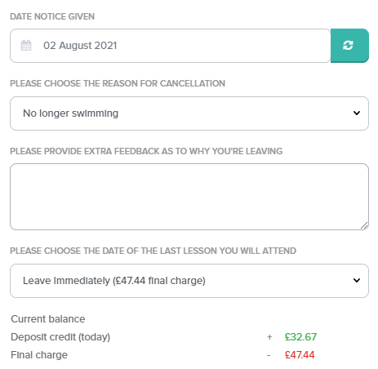
Cancel
30-Day Cancellations
What to do if a Customer wants to cancel their Monthly Plan.
Click on the image below to play the video – you may need to right click for it to open. (an internet connection is required)

Slide 7
Check out the Franscape Knowledge Base for more instructional articles
If you need support, contact support@franscape.io

